Slide 1
Engaging Youth in School Food Policy
Notes:
Begin with talking about our partnerships with the schools which led to our NEOP grant which gave us an opportunity to expand our youth engagement to nutrition and physical activity

Slide 2
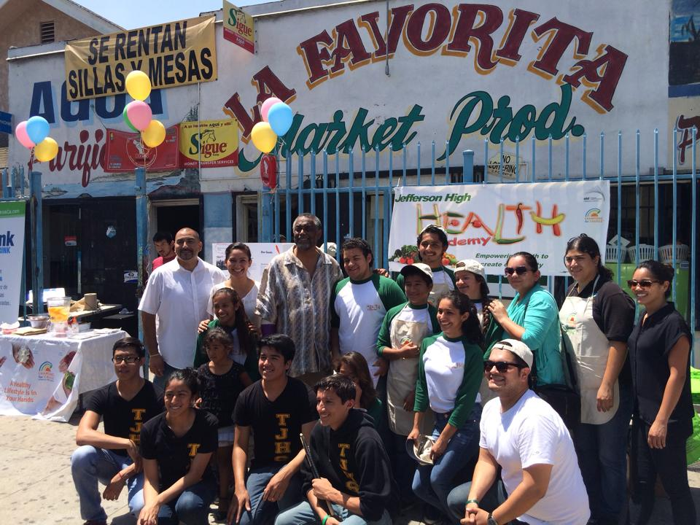
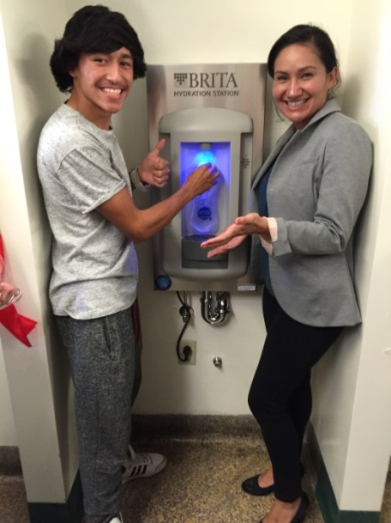
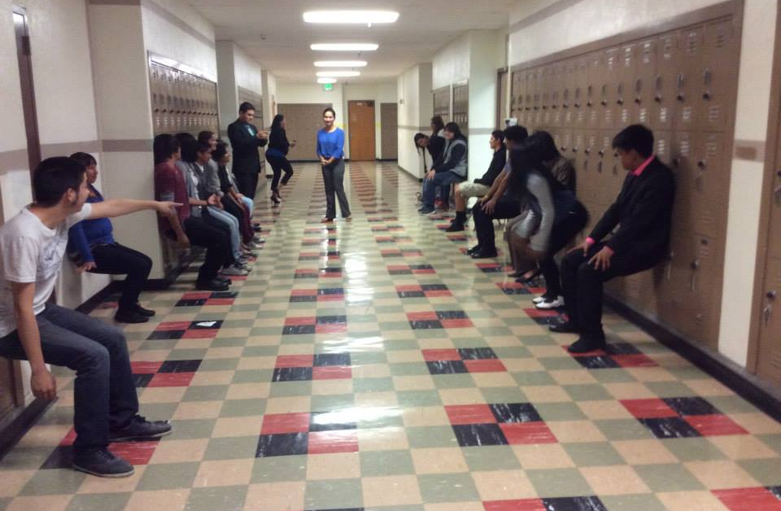
Nutrition Education Obesity Prevention (NEOP) Grant
4 youth-led Policy, Systems, and/or Environmental Changes (PSE) projects
40+ youth who meet weekly at Thomas Jefferson High School in South LA
Nutrition education-based and youth empowerment curriculum
Notes:
NEOP Grant Goals:
Reduce rates of obesity
Increase access to and consumption of fruits and vegetables
Improve access to physical activity (open space, mobility, programs)
Briefly discuss how we recruit students into HA
Discuss partnership with

Slide 3
Health Academy Projects
National Health Foundation
Market Makeover
Cafeteria Makeover
Hydration Station
School Wellness Council/ HA Mini Farm Stand (BIC)
Youth Participatory Action Research
Assess the environment
Develop action plan
Engage the community
Gain stakeholder support
Document public health outcomes
Notes:
Discuss how projects are chosen
YPAR
Assess the environment
Develop action plan
Engage the community
Gain stakeholder support
Document public health outcomes

Slide 4
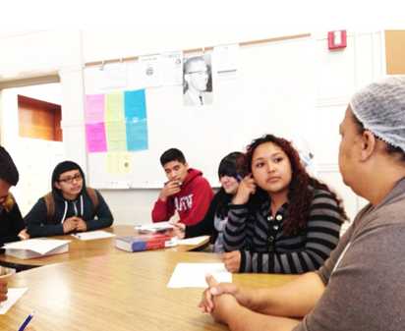
Veggies Over Everything
Project: Cafeteria Makeover
Work with Cafeteria Manager to increase participation in the school lunch program.
Tools used:
Smarter Lunchroom Movement
Peer-to-Peer Surveys
Participation Data
Partnerships
Cafeteria Manager
School Administration
UEPI
Notes:
Discuss partnership with Cafeteria Manager
Come as an assistance to her work
Ways to enhance engagement between cafeteria and students
Develop innovative ideas to increase participation
Goals of Project:
Increase consumption of healthy food
Develop low cost to free ideas to increase participation
Reduce food waste
Increase student voice

Slide 5
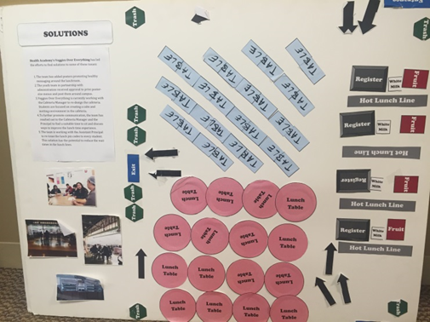
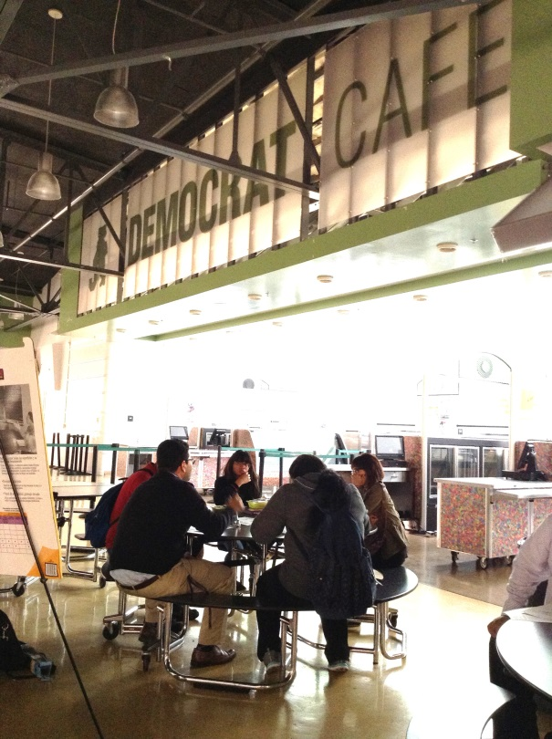
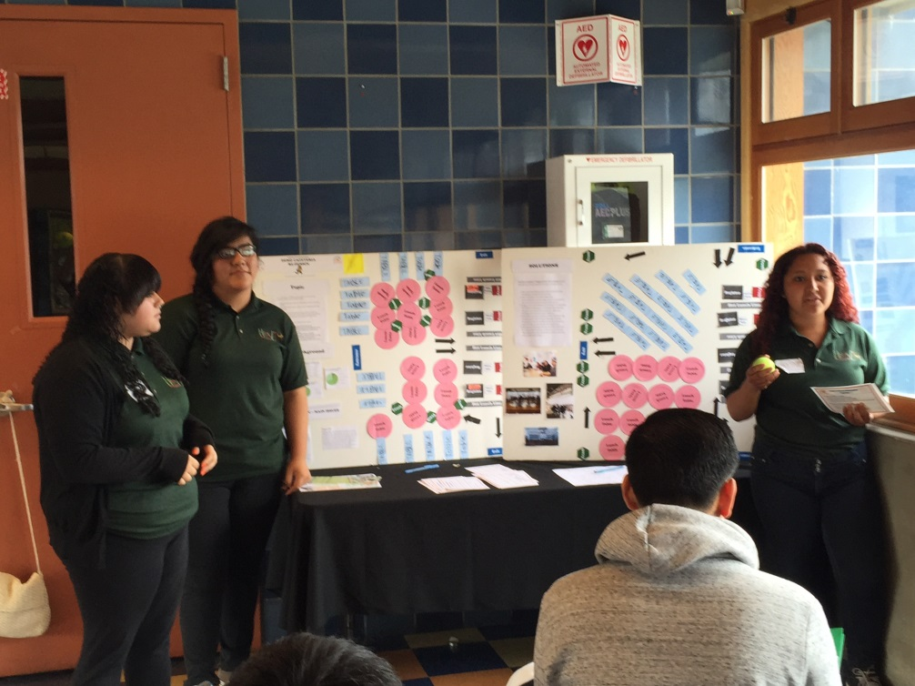
Notes:
Discuss: Cafeteria Makeover
Decrease wait times
Change the environment of the cafeteria that minimizes disruptions to eating
2015: 19% reported less than a 5 min wait, 2016: 70% report less than a 5 min wait
Retention
Expose students to the bigger picture of why this is important
Presentations
Inclusion and honesty in process of project development
Student schedules (tutoring, sports, work, etc)
Partnership with LAUSD
Taste Testing
Data and policy information
Informed on challenges across the district
Challenges
Scheduling meetings with Cafeteria Manager (leaves before school is over)
Students own perception of cafeteria meals
Options: Junk Food in schools, corner stores, vending machines
Time allocated for lunch (not enough)
Lessons Learned
Incorporate teachers into the process for increasing participation. (creating a culture of health)
Facilitate a dialogue between students, cafeteria manager, and school admin to develop a method to encourage healthy eating among student body.

Slide 6
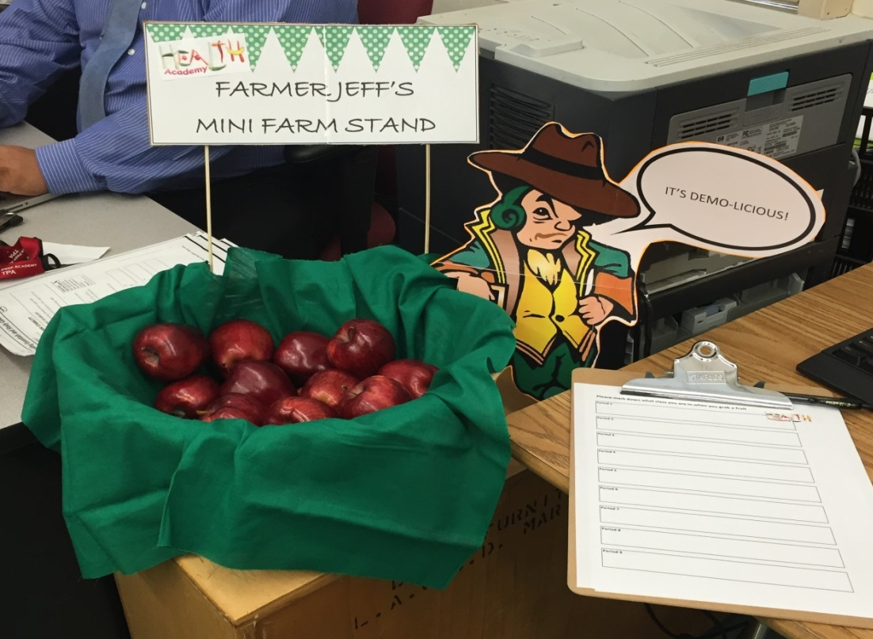
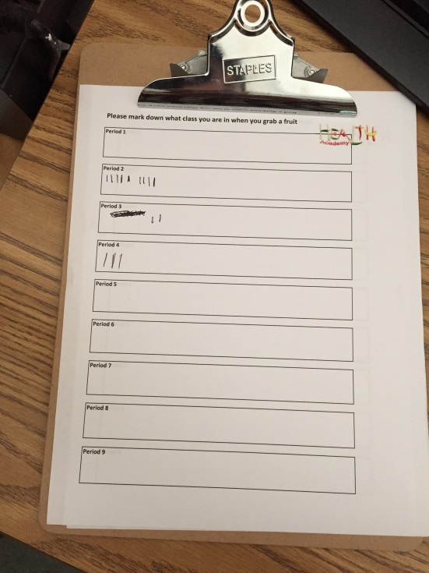
Health Academy Mini Farm Stand
Notes:
Time permitting: Discuss aspects of the program and hope to work with LAUSD to discuss project
Discuss project goals
Reduce food waste
Increase access to healthy food.

Slide 7
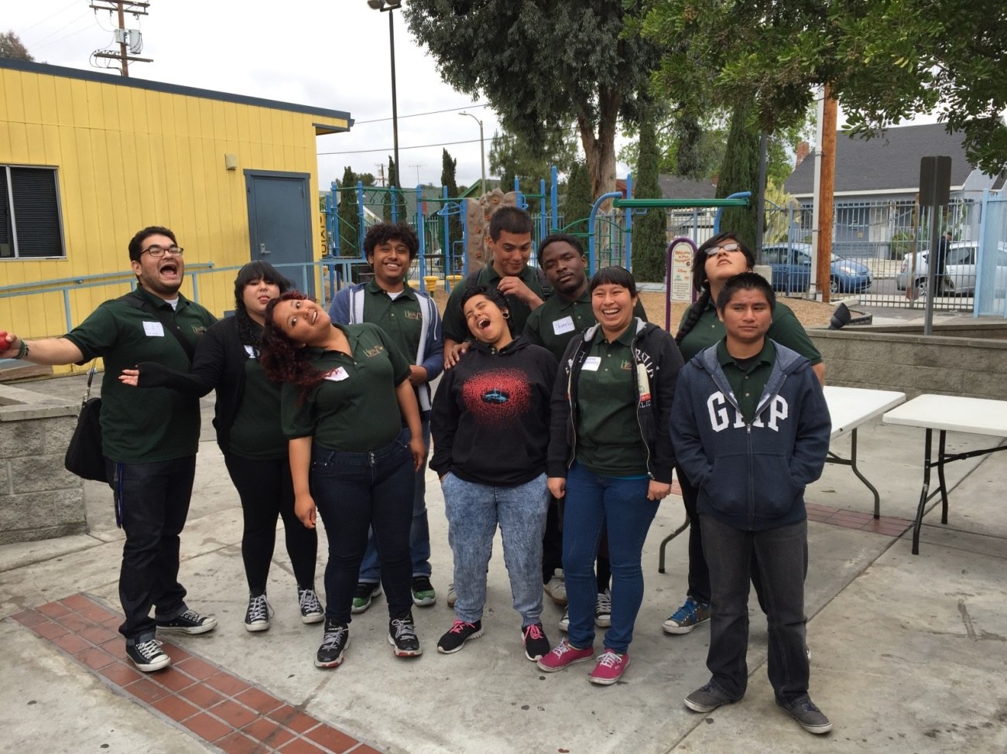
Questions??
Raymond Diaz, Senior Program Coordinator
rdiaz@nhfca.org
Notes:
What would you say to organizations that want to work on these topics?

